Slide 1
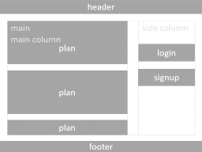
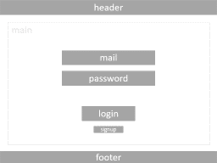
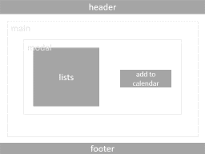
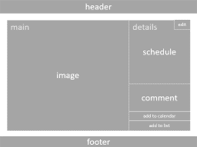
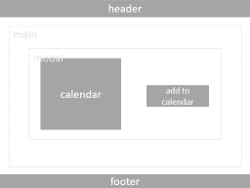

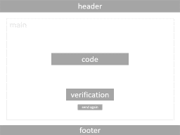
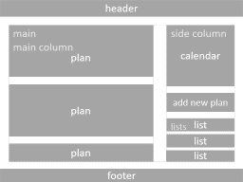
1
4
5
6
2
3
9
11
7
8
10
12
Notes:
login and signup

Slide 2
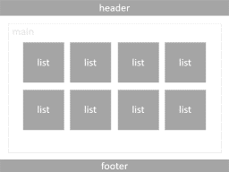
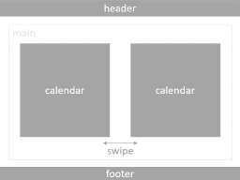
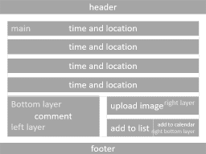
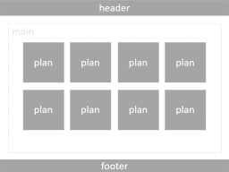
Notes:
timeline

Slide 3
header
plan
main
main column
side column
login
plan
signup
plan
footer
Notes:
Timeline (logged out)
Input: User, Plans

Slide 4
header
plan
main
main column
calendar
side column
plan
add new plan
list
lists
list
plan
list
footer
Notes:
Timeline (logged in)
Input: User, Plans, Calendar, Lists (Userクラスを作る？)

Slide 5
header
edit
image
schedule
main
details
comment
add to calendar
add to list
footer
Notes:
Plan Input: Plan

Slide 6
header
main
time and location
time and location
time and location
time and location
comment
left layer
right layer
Bottom layer
upload image
right bottom layer
add to list
add to calendar
footer
Notes:
Make plan (without Google Maps API)
Input: None

Slide 7
header
main
footer
Notes:
Make plan (with Google Maps API)
Input: None

Slide 8
header
main
calendar
calendar
swipe
footer
Notes:
Calendar Input: Calendar

Slide 9
header
main
list
list
list
list
list
list
list
list
footer
Notes:
Lists (Calendarと統合する？) Input: Lists

Slide 10
header
main
plan
plan
plan
plan
plan
plan
plan
plan
footer
Notes:
List modal Input: List

Slide 11
header
main
mail
password
signup
login
footer
Notes:
Signup modal

Slide 12
header
main
code
verification
send again
footer
Notes:
Verification modal

Slide 13
header
main
mail
password
login
signup
footer
Notes:
Login modal

Slide 14
header
main
modal
calendar
add to calendar
footer
Notes:
Calendar modal

Slide 15
header
main
modal
lists
add to calendar
footer
Notes:
List modal

Slide 16
Class User(): mail
name
password
calendar
lists

Slide 17
Users | Users-ID | Name | Mail | Password
 | CHAR | CHAR | CHAR | CHAR
Plans 投稿日時も追加 | Plans-ID | Title | Schedule | Image | Comment | Users-ID | Original
 | INT | CHAR | TEXT | ? | TEXT | INT | BOOL
Calendars | Calendars-ID | Users-ID | Plans-ID | Date
 | INT | INT | INT | DATETIME

